Slide 1
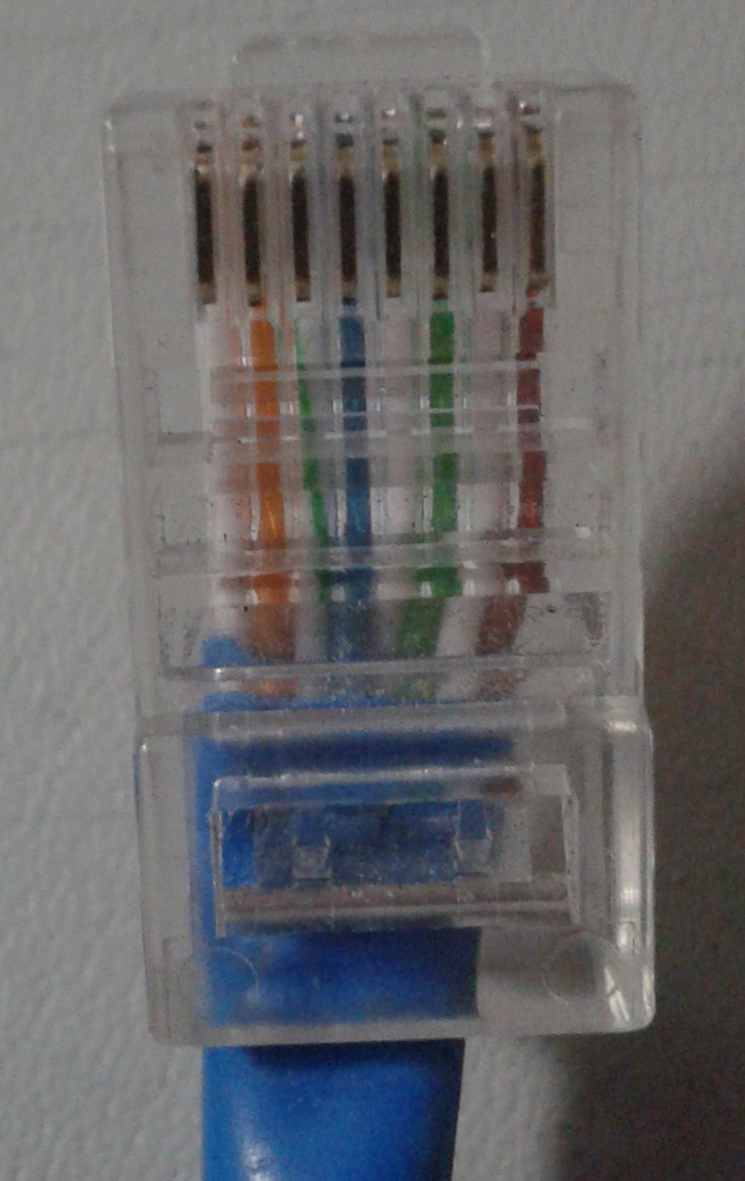

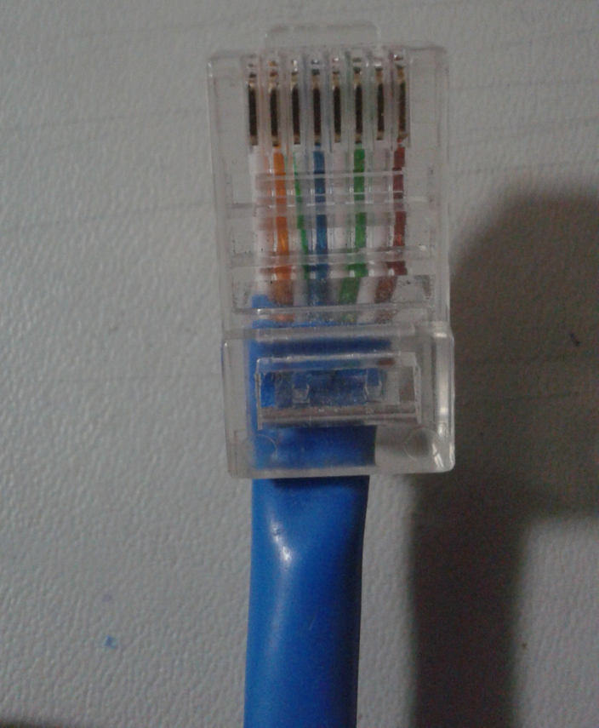
RJ-45 8pin Cable Wire (Straight)
Blue
Green
Striped
Green
Striped
Brown
Brown
Orange
Striped
Blue
Striped
Orange
™

